Slide 1
Invoice recognition
Tayyeba Muhammad khan
Supervisor
Sami ur rehman

Slide 2
Progress report
Nltk book reading nltk setup and tutorials
Core nlp setup
Previously done template:
Northwell

Slide 3
now working on html template
Parsing through the beautifulsoup and using tags to extract information

Slide 4
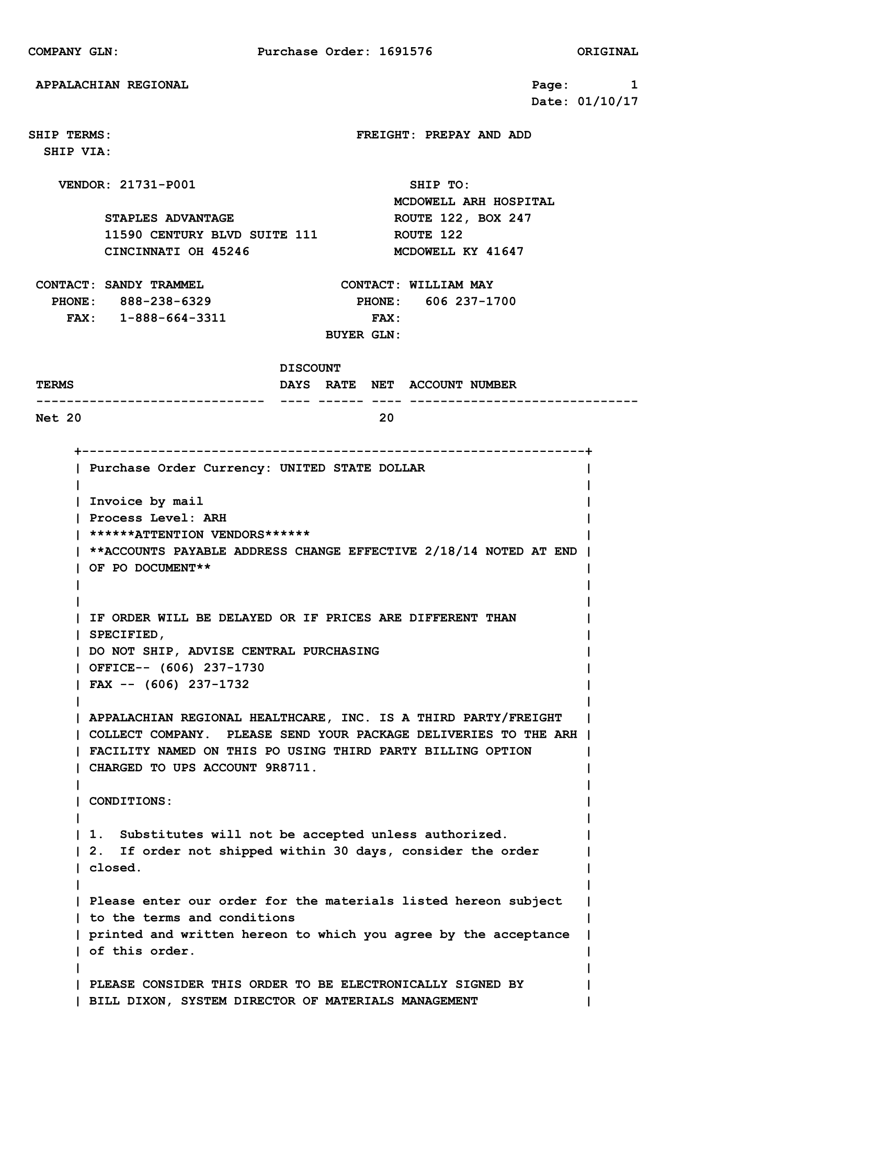

Slide 5
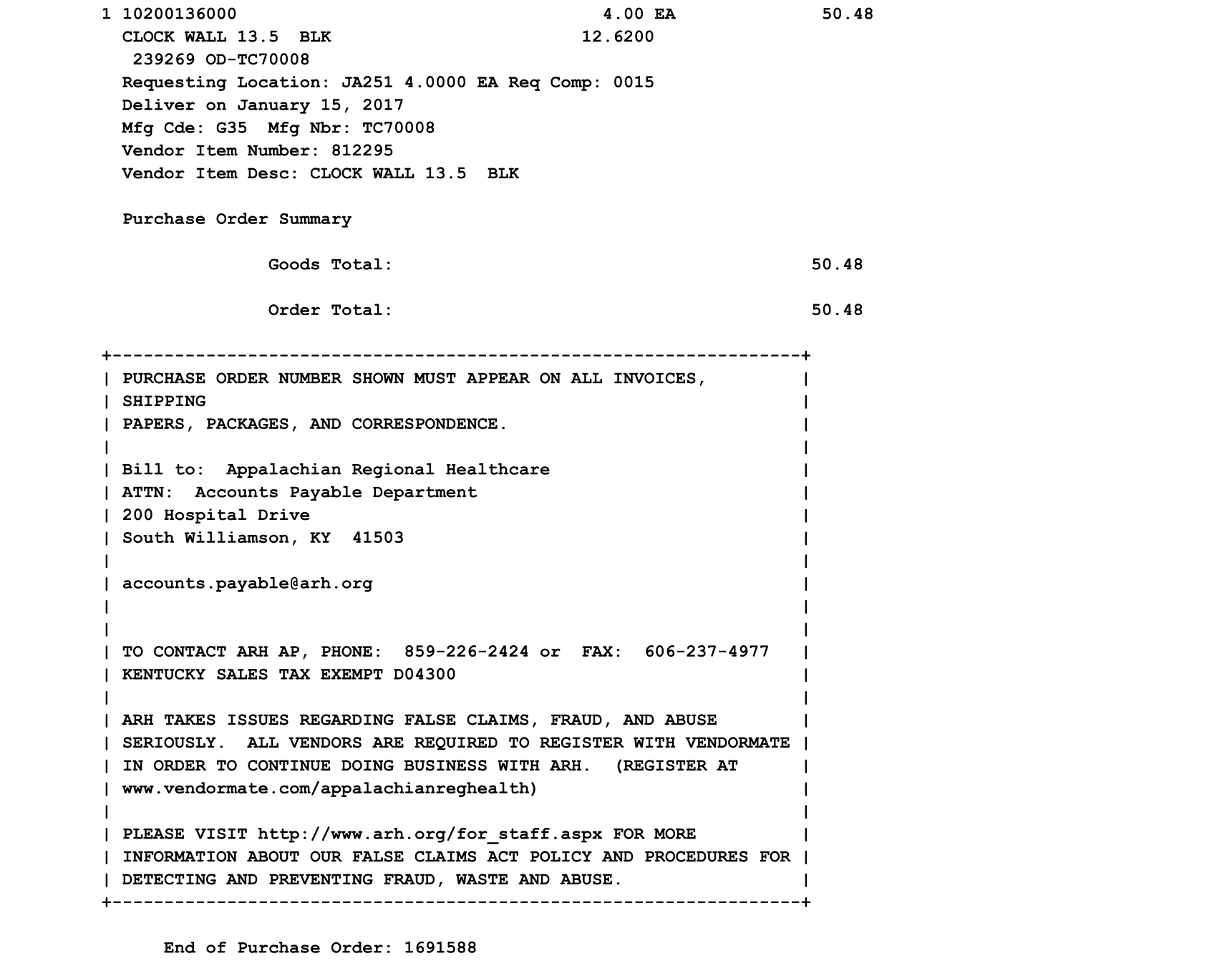
appalachian
Example 2

Slide 6
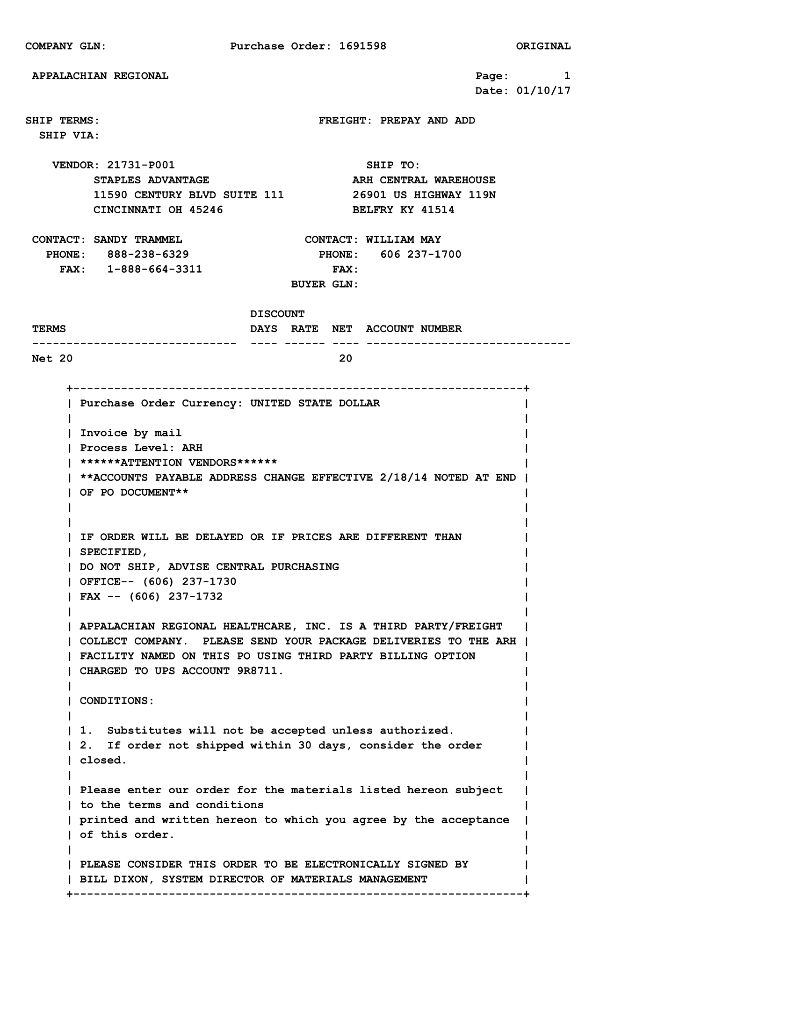
appalachian
example3

Slide 7
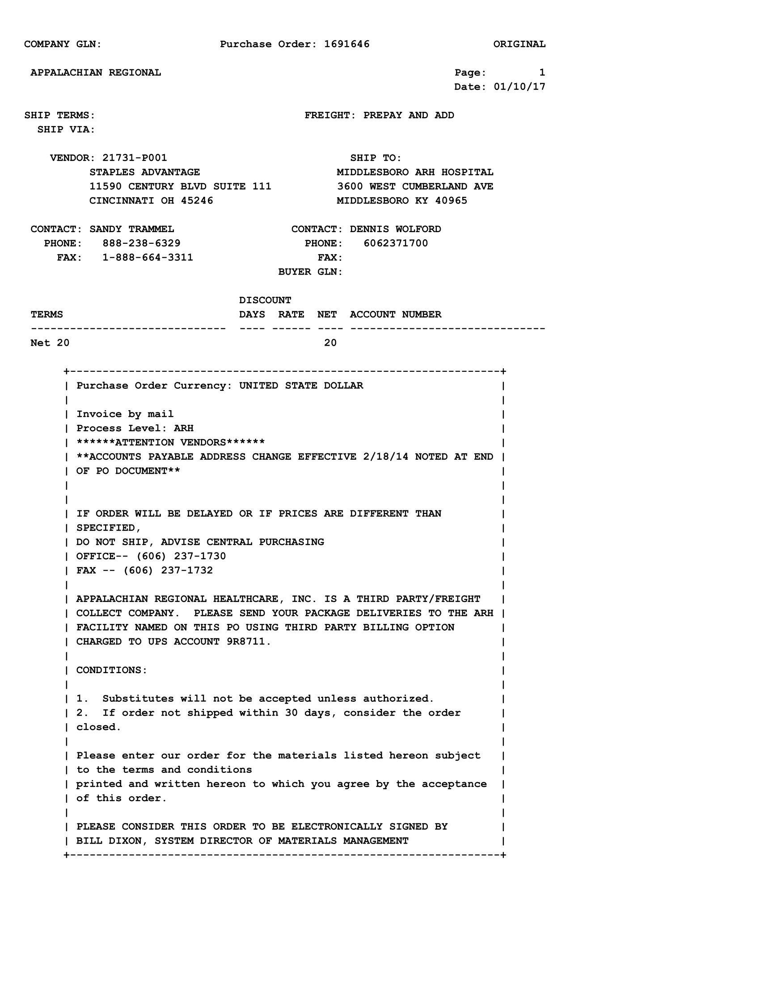
Appalachian example 4

Slide 8
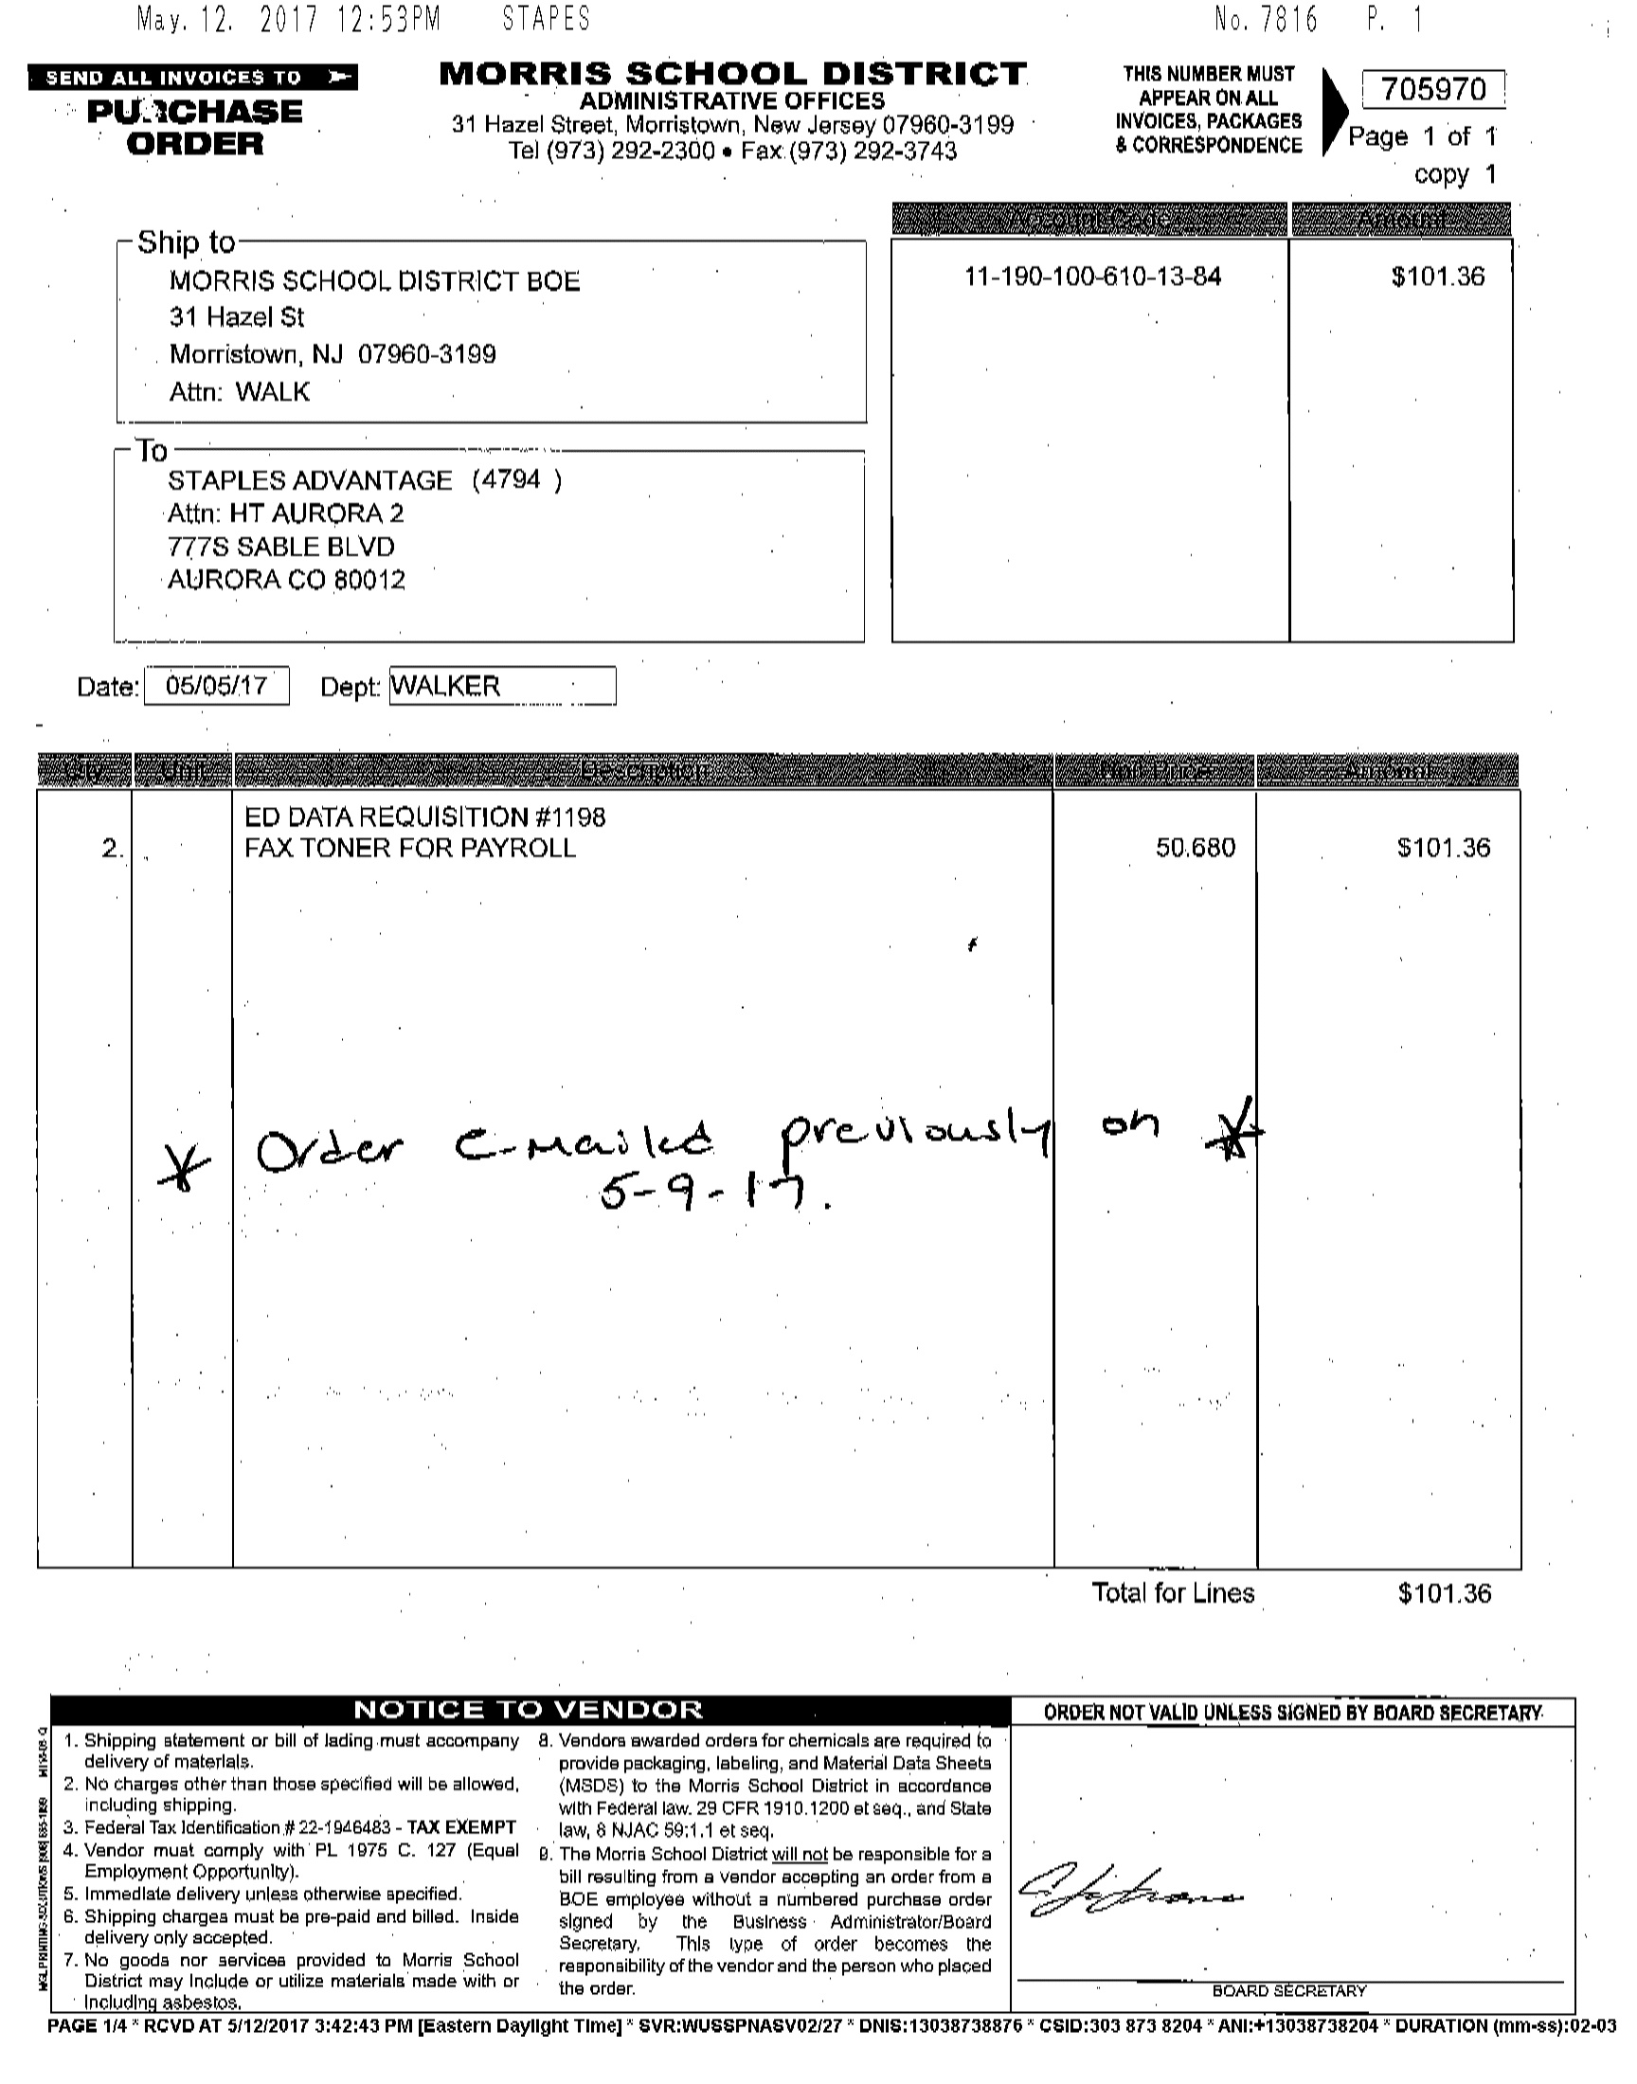
Ed data exmaple1

Slide 9
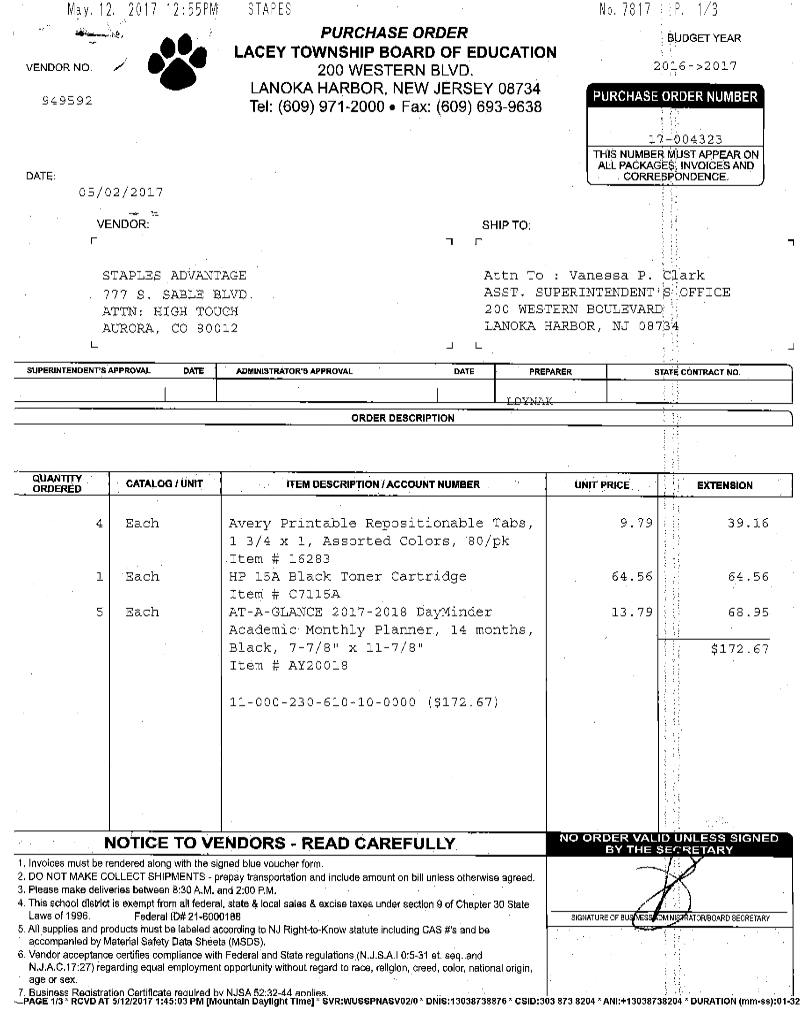
Ed data example 2

Slide 10
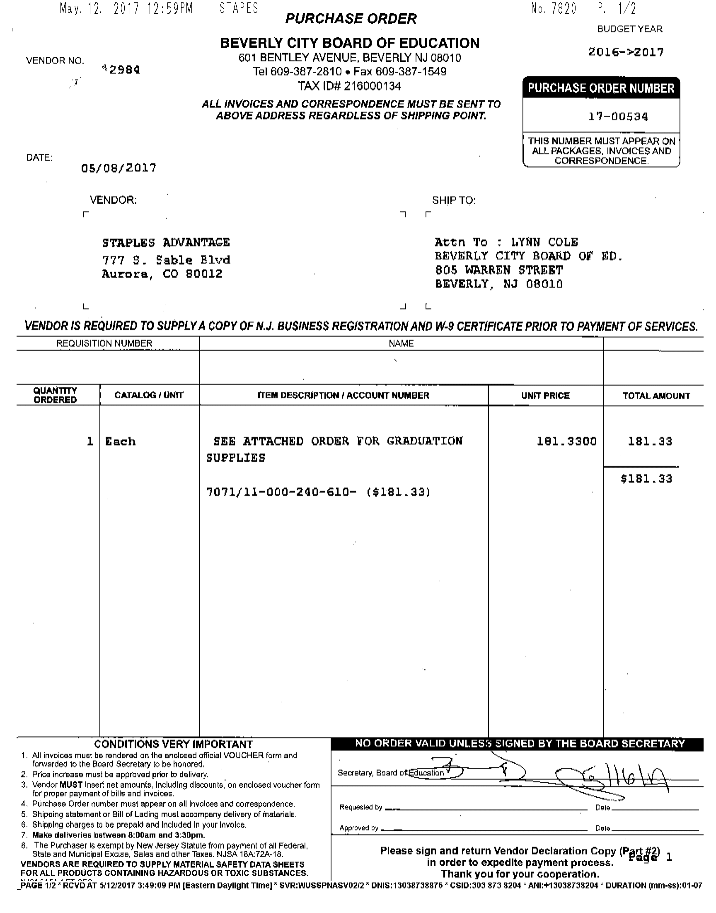
Ed data example 3

Slide 11
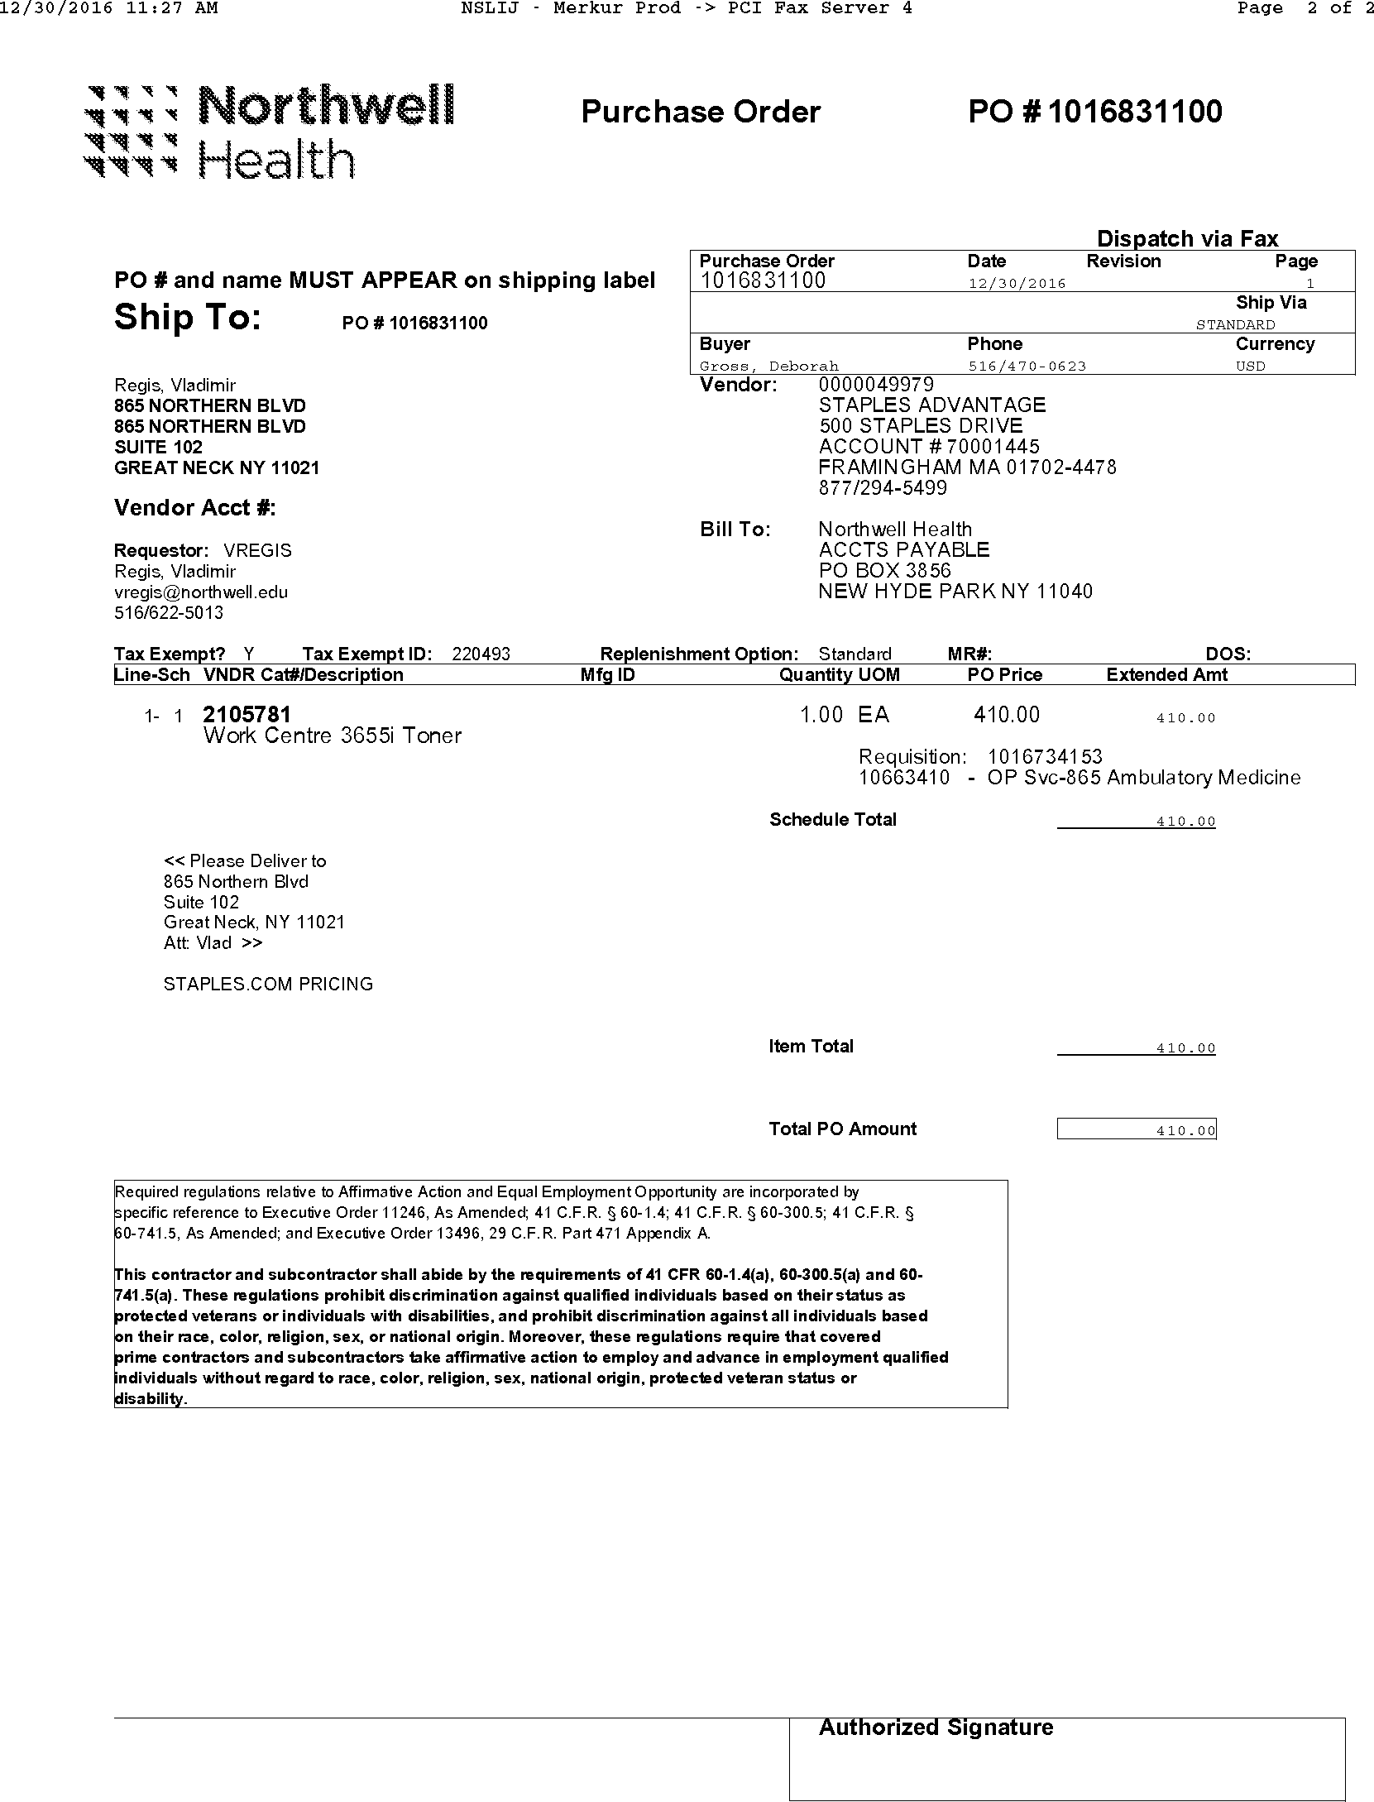
Northwell example 1

Slide 12
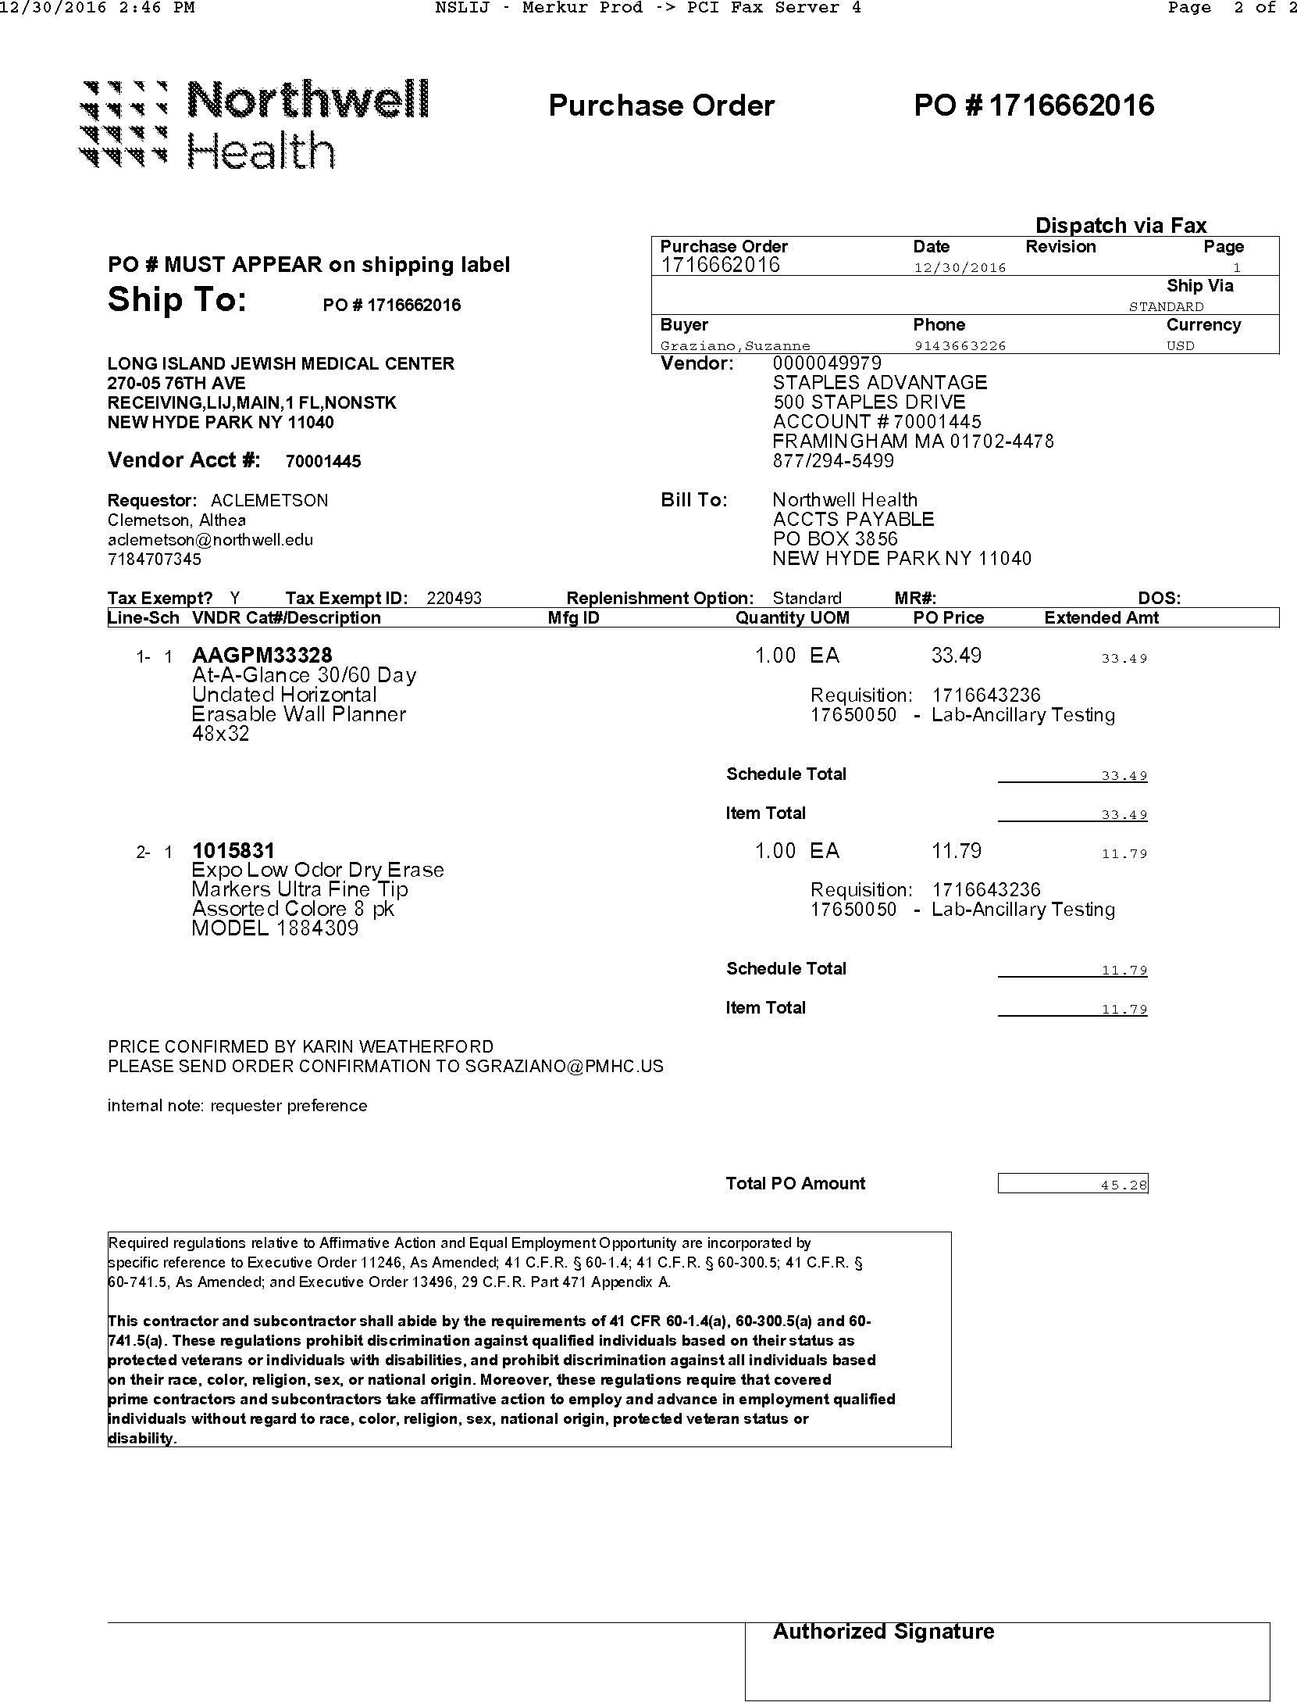
Northwell example 2

Slide 13
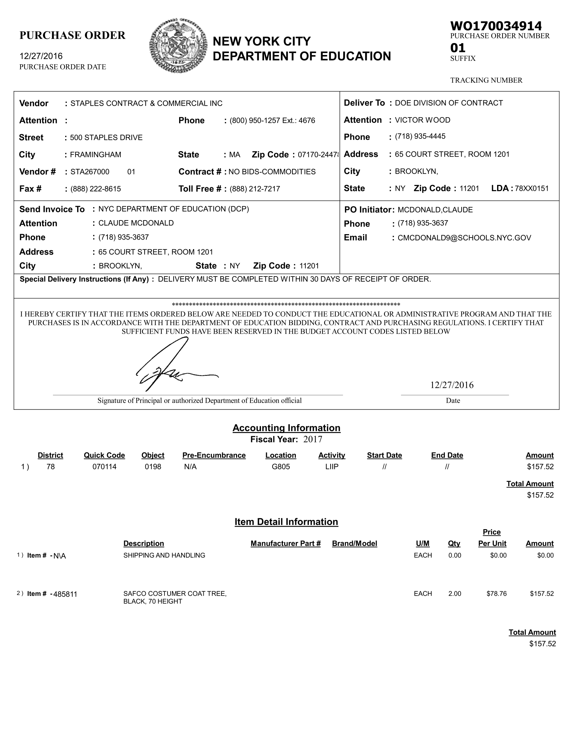
Nyc example 1

Slide 14
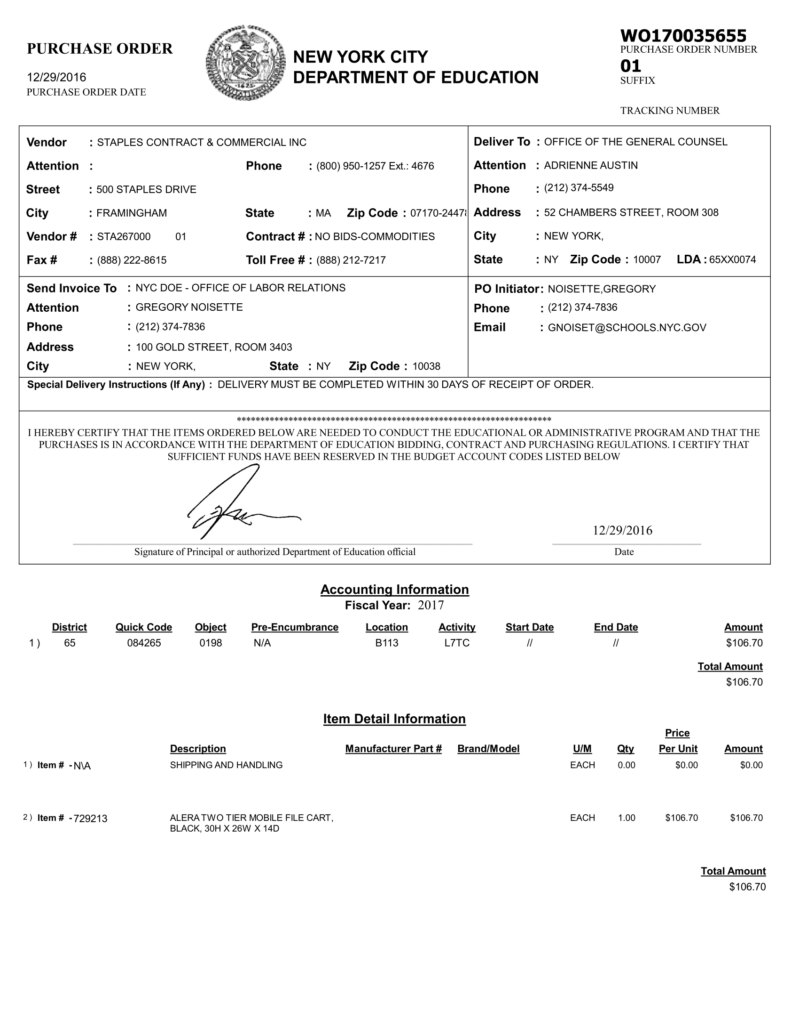
NYC example 2

Slide 15
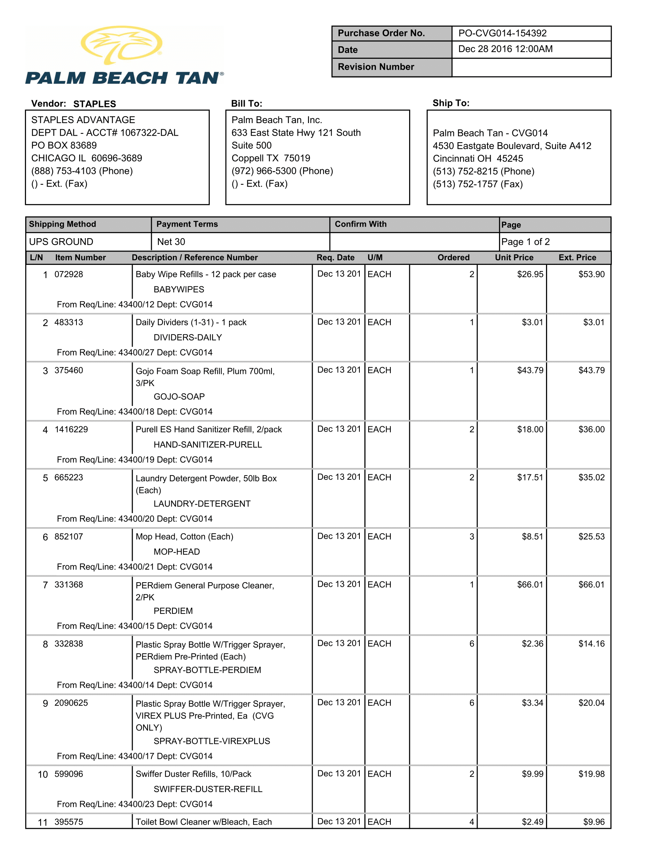
Palm beach example 1

Slide 16
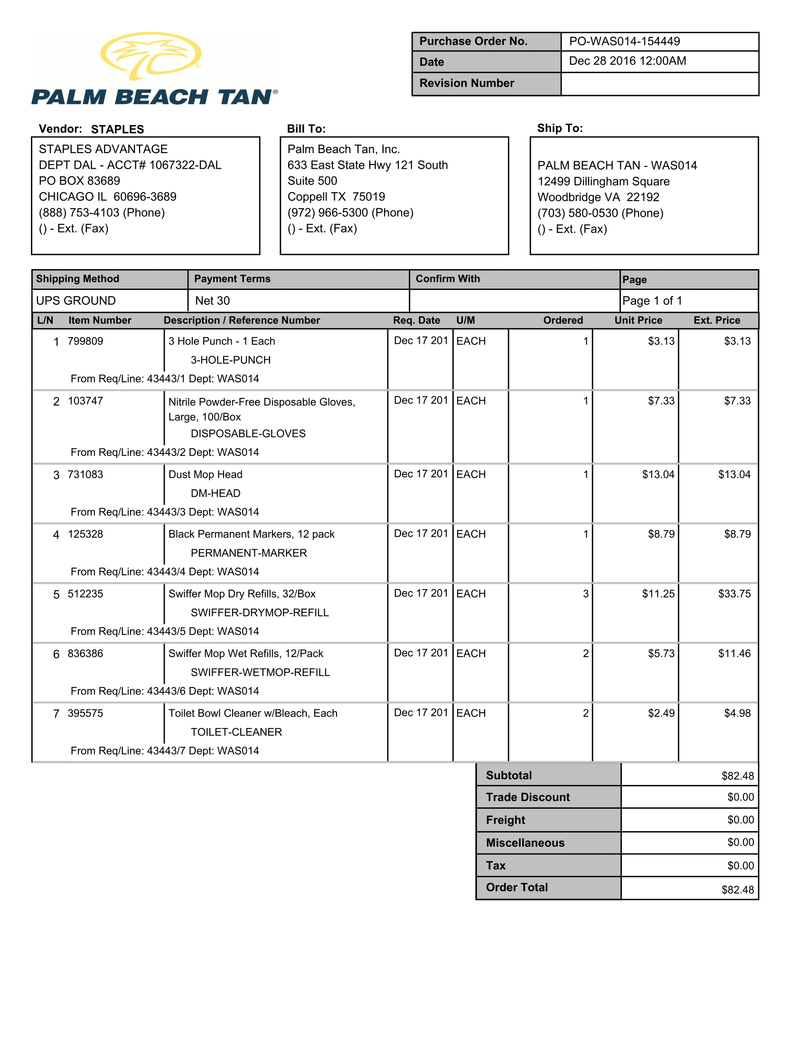
Palm beach example2

Slide 17
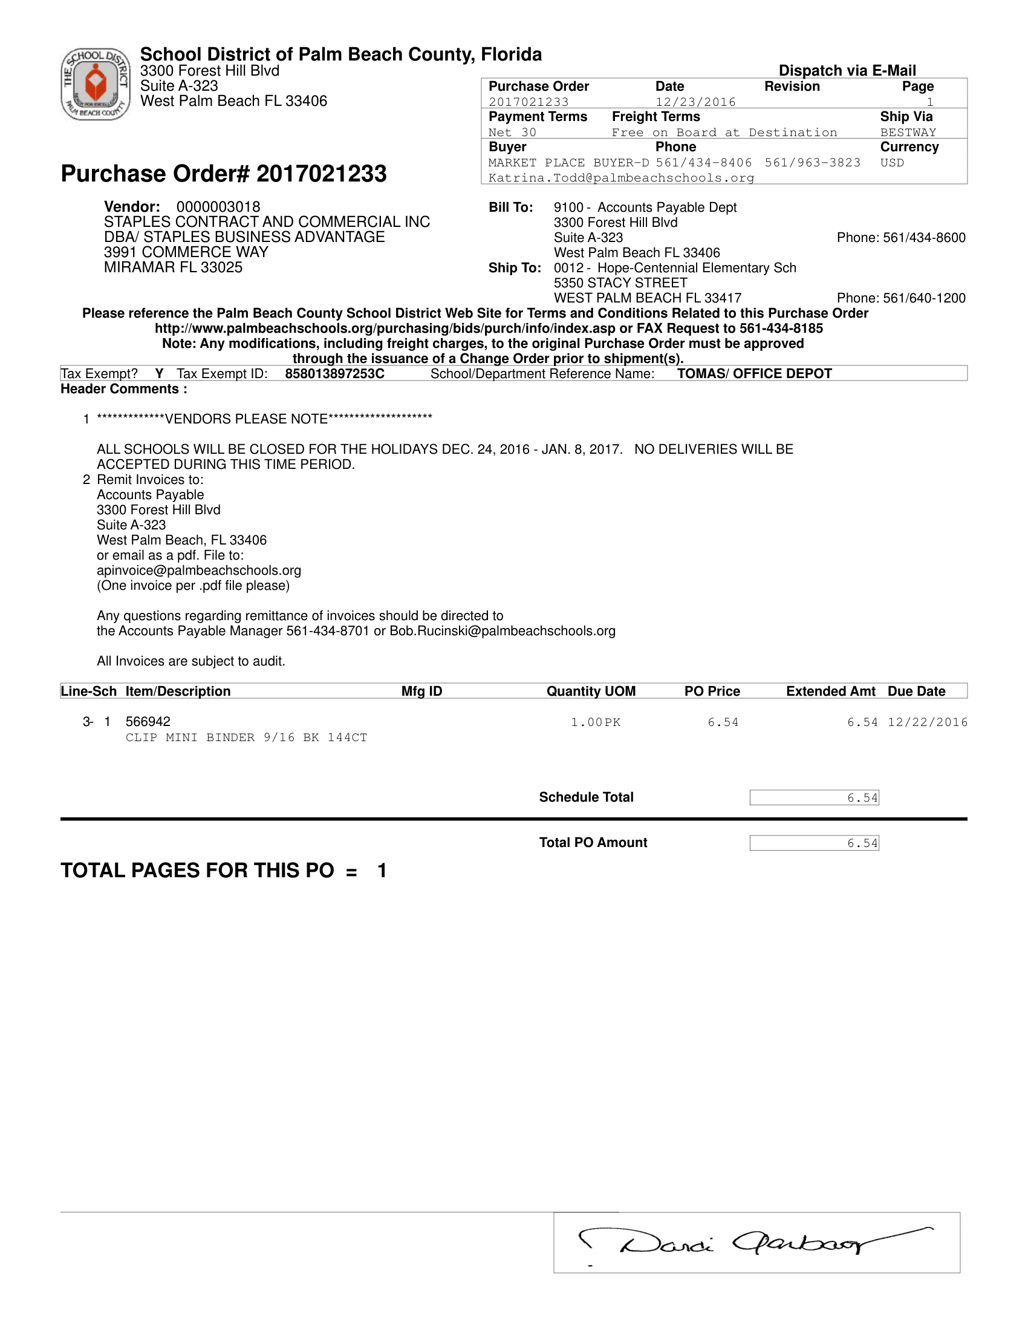
Palm beach sd 1

Slide 18
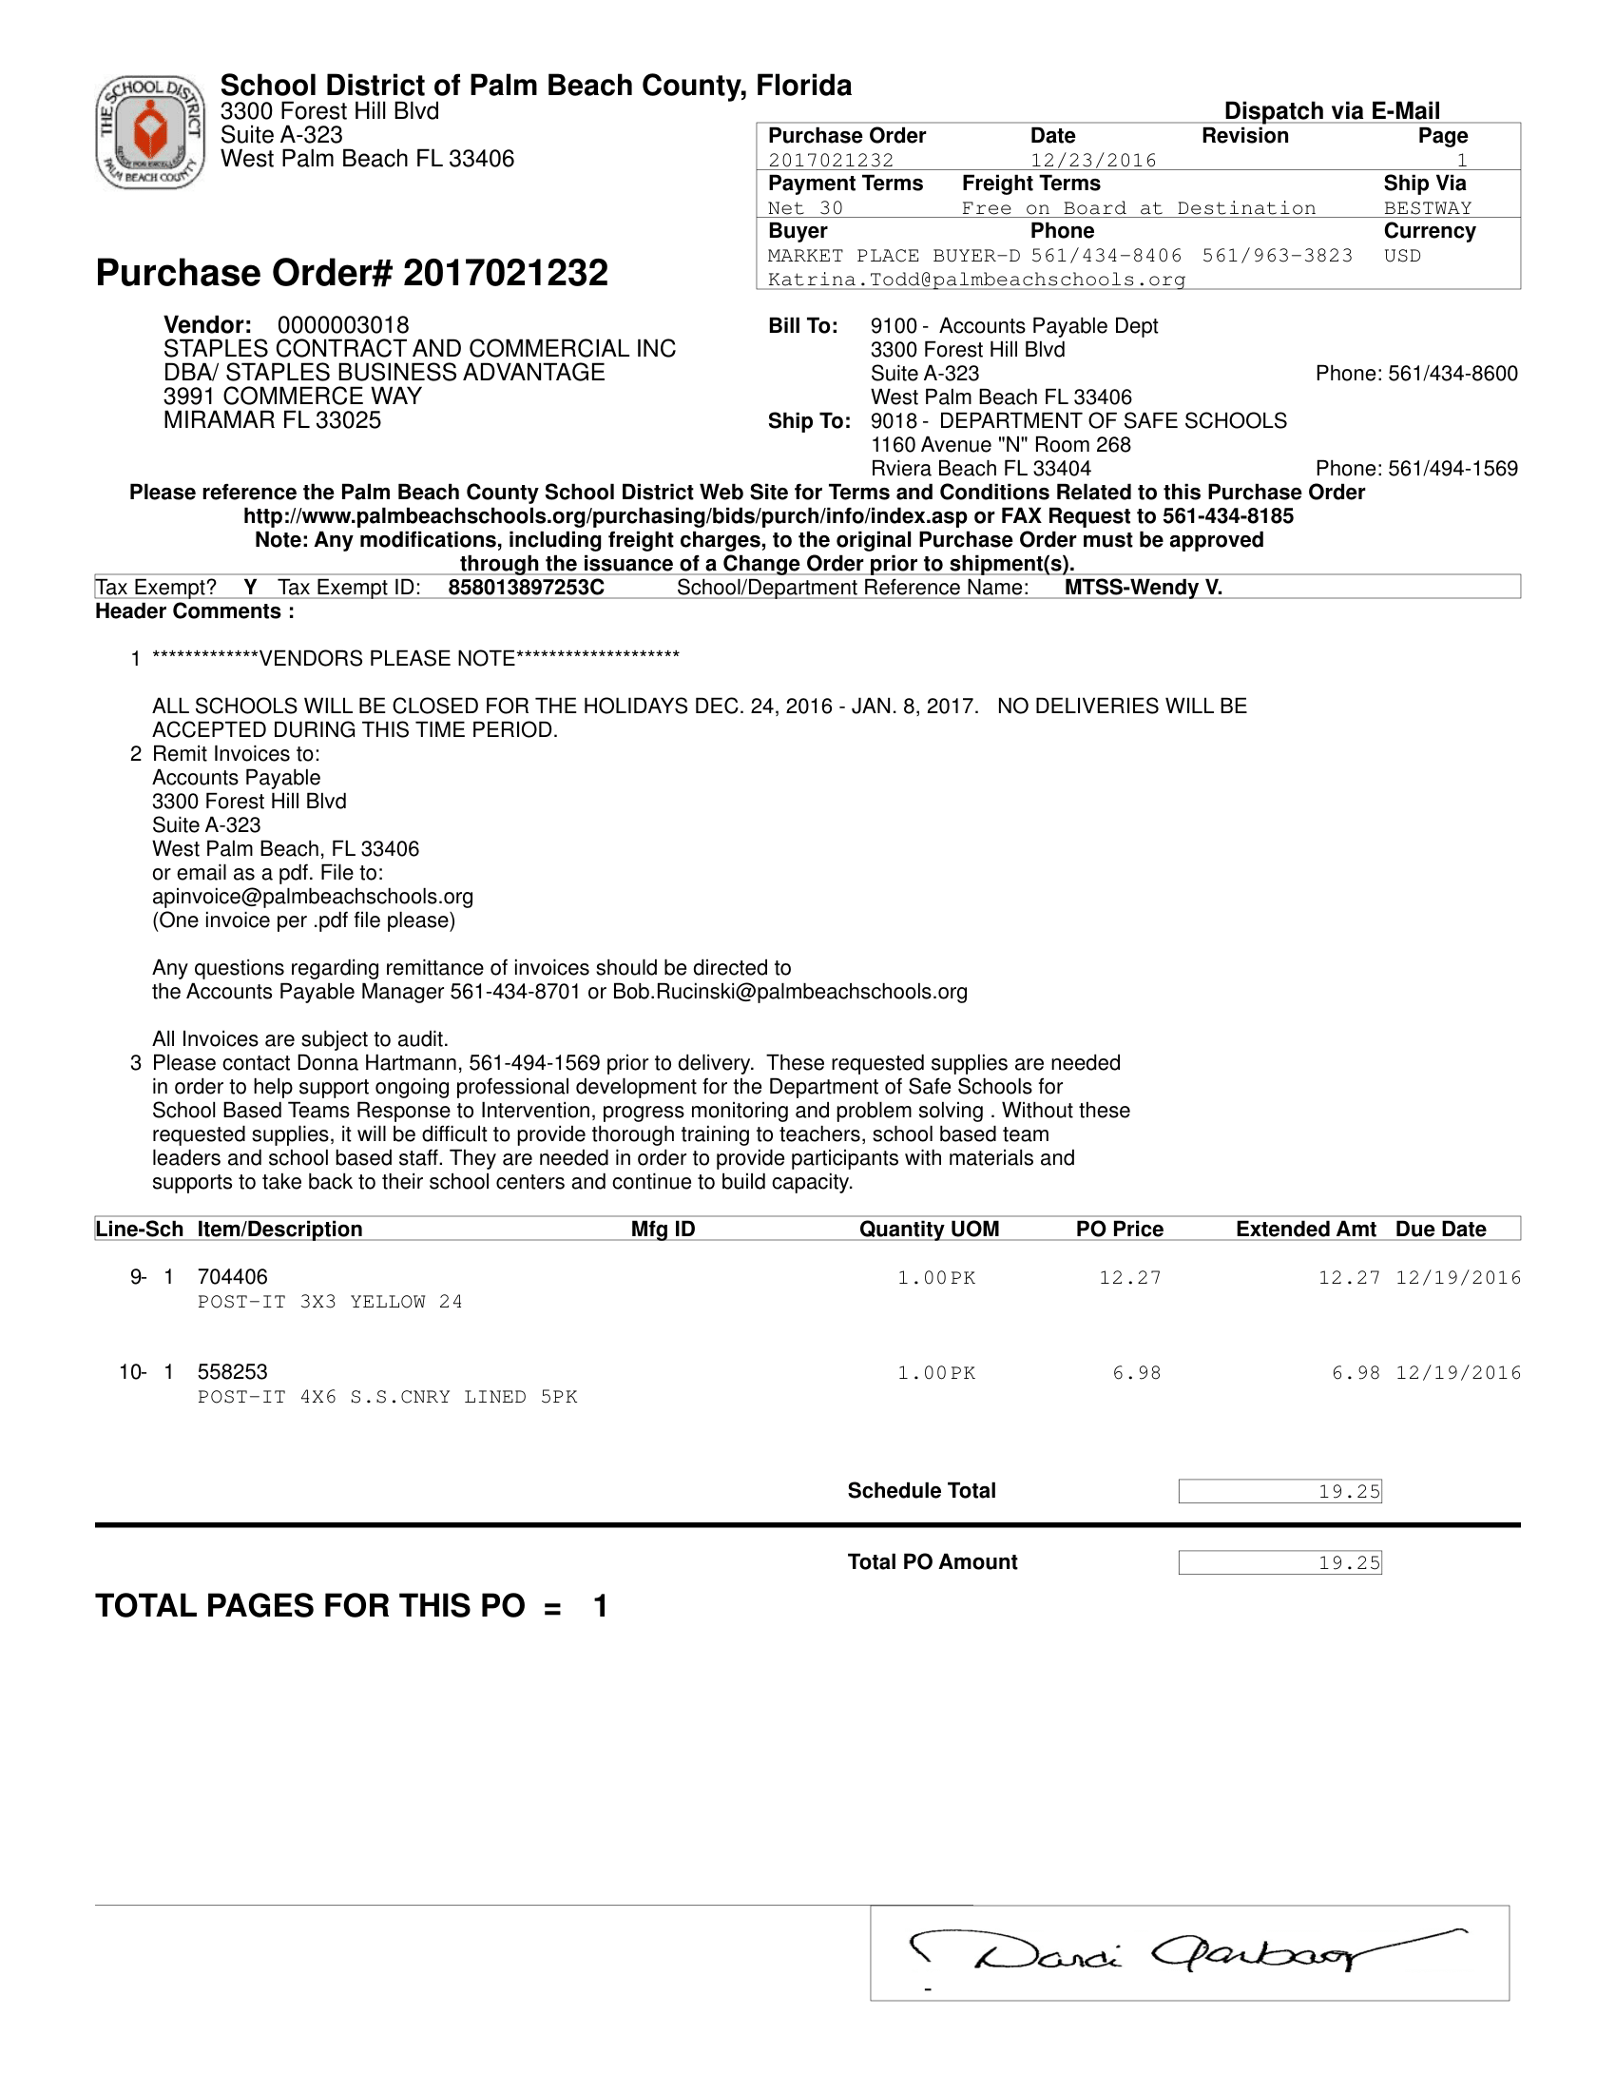
Palm beach sd2

